Slide 1
Welcome to
Curriculum Night!
2016-2017

Slide 2

Agenda for Curriculum Night
5:30-6:00 Classroom Session 1
6:00-6:15 PBIS Expectations Activity
6:15-6:45 PTA Meeting
6:45-7:00 PBIS Expectations Activity
7:00-7:30- Classroom Session 2
Both sessions are the same! We will cover the following:
  A typical day in Kindergarten
  Curriculum in Kindergarten
  Behavior
  Important Information
  Questions

Slide 3

Who is teaching my child?
Teacher: Jenna Beauregard. I can be contacted by e-mail, phone, or notes in the B.E.E. folders
You can also follow me on Twitter
  @mrsjbeauregard
Assistant: Ms. Wooten

Slide 4

Typical Day in CCK
Tuesday-Friday
1st Quarter
9:15-9:30 Morning Meeting
9:30-10:00 Writing (Writer’s Workshop)
10:00-10:50 Literacy (Daily 5)
10:52-11:52 K-2 Domain
11:55-12:25 Recess
12:25-12:45 Literacy (Letterland)
12:45-1:20 Lunch
1:35-2:15 Electives
2:15-3:15 Math
3:15-3:40 Read aloud/Developmental Centers
3:40-3:45 Prepare for dismissal

Slide 5

Monday Schedule
9:15-9:30 Morning Meeting
9:30-10:00 Writing (Writer’s Workshop)
10:00-10:52 Literacy (Daily 5)
10:52-11:52 Domains
11:55-12:25 Recess
12:25-12:45 Literacy (Letterland)
12:45-1:20 Lunch
1:35-2:15 Electives
2:15-3:15 Math
3:15-3:40 Read aloud/Developmental Centers
3:40-3:45 Prepare for dismissal

Slide 6

Letterland
Letterland is a phonics-based approach to teaching reading, writing and spelling. The Letterland characters transform plain black letter shapes into child-friendly pictograms and they all live in an imaginary place called Letterland.
Simple stories about the Letterland characters, explain the full range of dry phonics facts so that children are motivated to listen, to think and to learn. These stories explain letter sounds & shapes, allowing children to progress quickly to word building, reading and writing.
Letterland is used in all Kindergarten-2nd Grade classes in Wake County.

Slide 7

Writer’s Workshop
Writing mini-lesson
Students will focus on correct grip formation when holding a pencil
As student grow within their writing, they will be able to utilize correct letter formation when writing and will begin to write words
Students will begin to understand that sentences start with a capital and end with punctuation in order to write complete sentences.

Slide 8

Literacy (Daily 5)
Rotations throughout the literacy block.
5 literacy stations (Read to Self, Read to Someone, Word Work, Work on Writing, Listen to Reading)
Mini-lessons include shared reading, Letterland, and lessons on what good readers do (reading for comprehension, reading strategies, self check, etc.)
Differentiated instruction takes place during Meet with the Teacher, and is at the student’s instructional reading level.

Slide 9
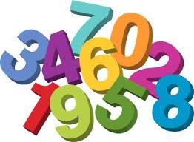
Math
Daily Routines provide repeated practice with rote counting, subitizing, skip counting and counting with one-to-one correspondence.
Topics include counting and cardinality, operations and algebraic thinking, problem solving, place value, measurement and data, and geometry.
Curriculum is spiraling.

Slide 10
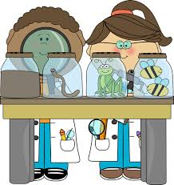
Science
Science units of study include:
*Investigating properties
    Hannah Hollingworth
  *Weather
    Katelyn Brisson
    *Animals 2x2 (organisms)
    Hannah Enos
    CCK students will rotate between teachers
    throughout the course of the year

Slide 11

Social Studies
Incorporated throughout the curriculum with story read alouds.
Time for Kids Magazine and community member visits (fireman, police officer, nurse, etc) help students apply learning to the real world.
Topics of study include:
- I am a citizen
-How we are Alike! How we are different!
-We have needs and wants
-What’s Around Me

Slide 12
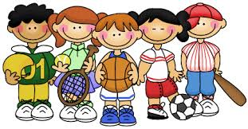
Domains & Electives
Students will go to both a domain and an elective Tuesday - Friday.
Students will go to both a domain and an special Tuesday - Friday.
Domains are semester long, electives change each quarter.
A variety of academic, visual/performing arts and physical education electives are available.

Slide 13
Homework
Kindergarten homework consists of reading to your child every night.
Check out the monthly newsletter for information about what we are learning and tips on how to support your little learner at home.
Why no homework?
The NEA and the National PTA do not endorse homework for kindergarten. This is researched based and it is suggested that kindergartners spend time at home playing outside and spending time with family and friends.
http://www.cnn.com/2015/08/12/health/homework-elementary-school-study/

Slide 14
Common Core &
Standards Based Grading
CCK is a specialized diagnostic and intervention program for students in need of individualized educational programming.
During this school year, additional assessments will be given to students before a decision is made about appropriateness of the Common Core Course of Study or the Adapted Curriculum.
This year, students are graded and assessed using the Common Core Standards.

Slide 15
Common Core &
Standards Based Grading
Students will receive 4 report cards and 4 interim reports this year. Standards Based Grading is used to determine each student’s grade.
Along with report cards, IEP progress notes will be sent home at this time.
Additional information about the Common Core Standards can be found on the Wake County Public School System website.

Slide 16
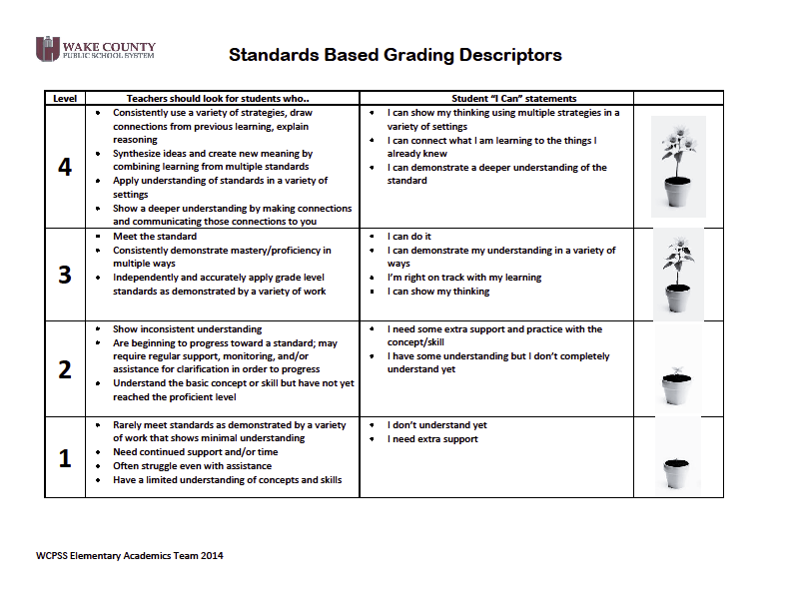

Slide 17

Panther Paws
Students receive Panther Paws throughout the school day. They save them for the pride cave where they can pick from small prizes, school supplies, books and intangibles like lunch with teachers or the Principal.
Classes receive class paws which are saved for Bronze, Silver and Gold class rewards. Class rewards may include PJ Day, Lunch in the classroom, extra recess, etc.
For students needing more behavior support, we utilize the following steps:
  1. Token chart
  2. Think About it seat with a toolbox of taught coping strategies
  3. Think Sheet filled out by the student with teacher assistance and sent home for parent to sign.
  4. Phone Call or email
  5. Parent conference
Thank you for signing your students weekly communication log!
These are sent home on Thursdays in the B.E.E. folder - please remember to send them back on Fridays.

Slide 18
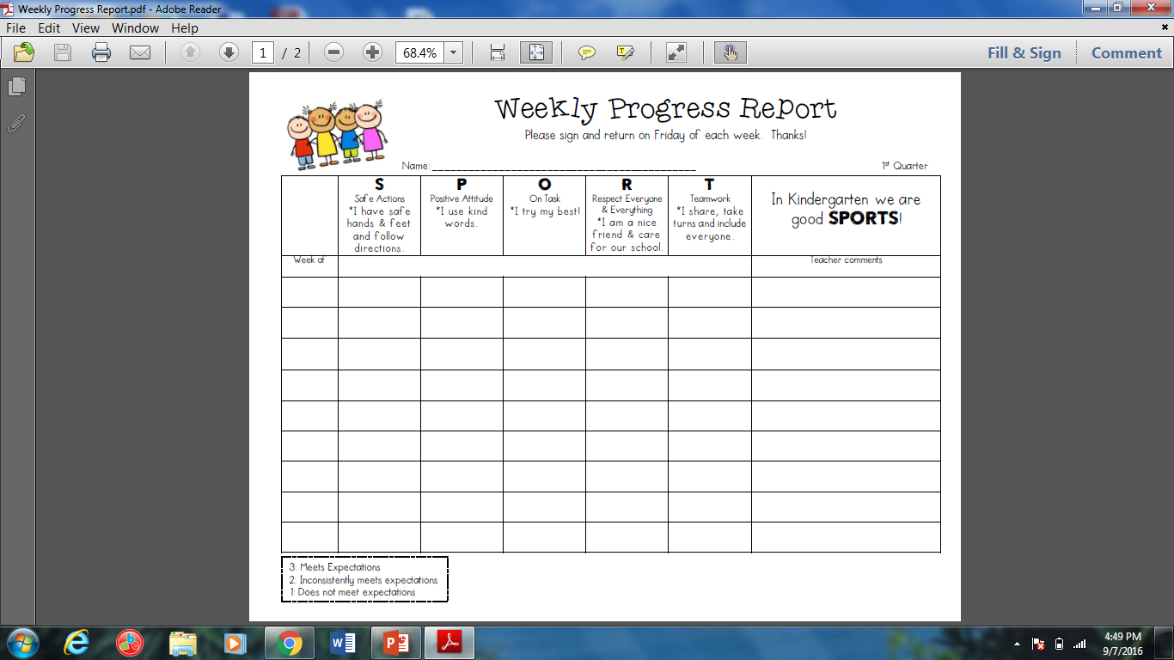

Slide 19
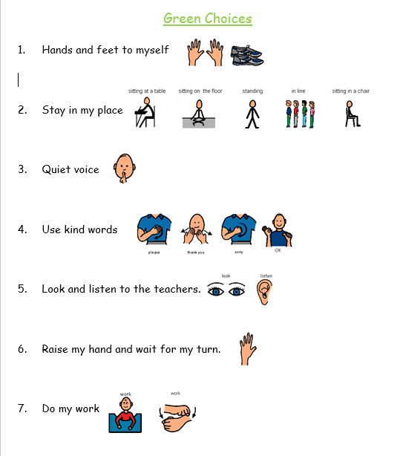
Green Choices

Slide 20

Field Trips
Kindergarten plans to take two
field trips this year.
The first is tentatively scheduled for the Raleigh Museum of Science on Wednesday, November 16th.
For the second field trip we are looking into a theatre experience in the Spring.
Chaperones are needed! Please register as a volunteer on any WCPSS computer. More information will come home ASAP.

Slide 21
Important Information
Snack: Students have a snack every day. If the student does not bring a snack, we have saltine crackers for them.
Library Books: Please keep library books in the bag at all times. Students will go to the library every week.
Extra Clothes: Please send in a set of seasonal-appropriate clothes incase of an emergency. We will send back the warm weather clothes when a new set is provided.
Parent Volunteers: Volunteers are always welcome in our class! You must register with Wake County before becoming a volunteer. Computers are available in the Library/classroom to register tonight!
Monthly Newsletter: Our newsletter has lots of important information and dates.
Remind 101: please sign up!

Slide 22

Upcoming Dates
September 9th- Early Release
September 30th- Early Release
October 21st- Early Release
October 27th-Fall Picture Day
October 28th- Race for Education
(Walk-a-thon!)
October 31st- Teacher Workday

Slide 23
Questions?
Please feel free to contact me anytime!
Jenna Beauregard
jbeauregard@wcpss.net
Check us out on twitter and be sure to visit the CCK website!
@PowellesPLAY
http://powellescck.weebly.com/

